Slide 1
Targeting the Reading Zone
Presented by Brian Jeffrey, M. Ed.
Los Osos High School Rancho Cucamonga

Slide 2
Let’s Discover How Students Think
Time to Take a Quiz: Targeting Reading Skills
Directions: What is the object you see on the yellow post-it before you? You have ten seconds to write your answer. Go!
Quiz
The correct answer is. . .
It depends on how you read it!

Slide 3
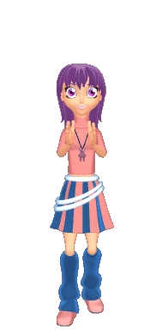
Student Choice
Students are more likely to read when they have to do something with a text they’ve been assigned.
Students are more likely to read when they can choose an assignment that appeals to their talents and learning styles.
Students are more likely to master the skills and standards being taught when they are taught to evaluate their own work

Slide 4
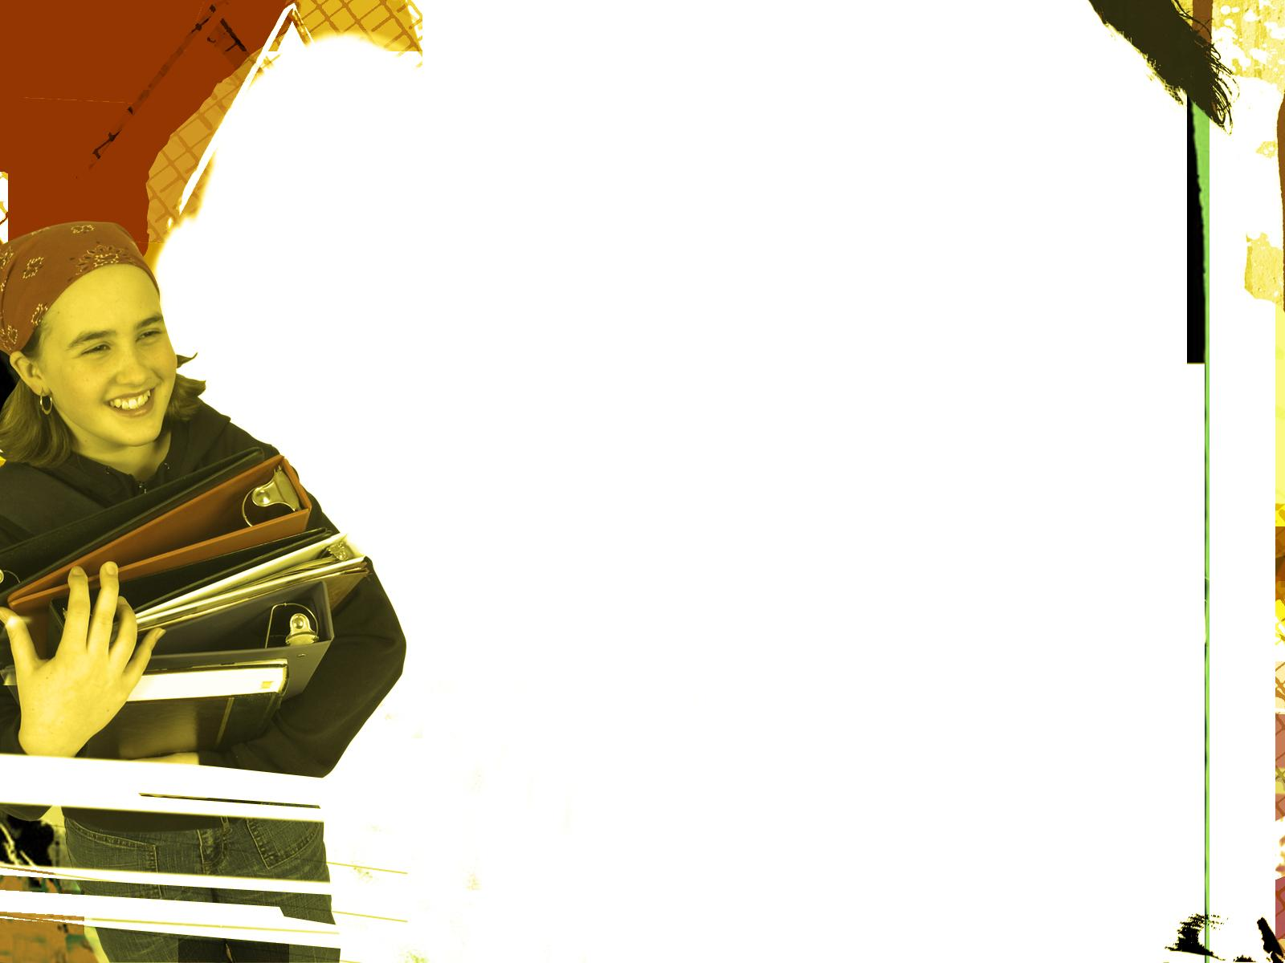
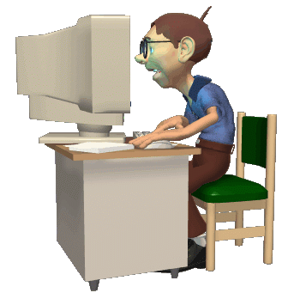
Using the Reading Response Zone
Analytical Mind Diagram
Culture Cube
Cornell Notes
Dramatic Structure
Elements of Fiction
Existential Inventory
Four Column Journal, QAP
Four Column Journal, SCE
Four Square
Haiku 4 You
Visit mrjeffrey.com

Slide 5
Using the Reading Response Zone
Headline
One Pager
Open Mind Diagram
Textbook Rubric
Transcendental Inventory
Two Column Journal
Upstairs/Downstairs
Venn Diagram
Window
X Factor
Visit mrjeffrey.com

Slide 6
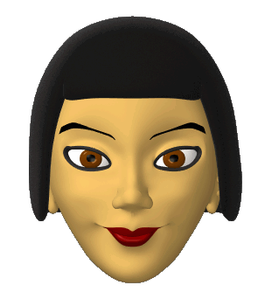
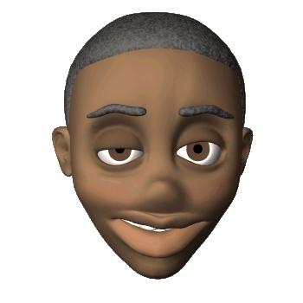
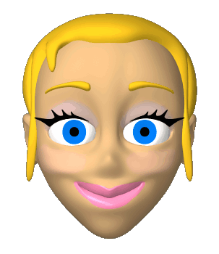
Students in Control of Learning
Clear instruction on what’s expected of them through use rubrics and guided instruction
Modeled evaluation of reading assignments
Students are allowed to turn in reading assignments for a higher grade after initial evaluation

Slide 7
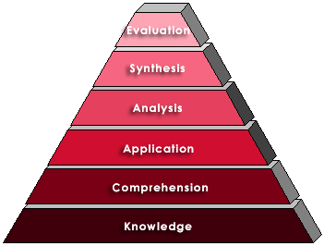
Creativity
Literary Response and Analysis Standard 2.3: Theme and Textual Evidence
Evaluation
Write one sentence explaining what you did well according to the skill being learned using the language of Bloom’s taxonomy. Then, write one more sentence explaining what you could do better or differently next time and how you could move up one level on Bloom’s Taxonomy.
Higher Order Thinking Skills
4.5 to 5/A
3.5 to 4.4/B
2.5 to 3.4/C
1.5 to 2.4/L
.1 to 1.4/K
Bloom’s Taxonomy
Student Directions for Written Evaluation
Lower Order Thinking Skills
Grading Scale
0 Errors = 4.5/A to 5/A 3 Errors - = 1.5/L to 2.4/L
1 Errors = 3.5/B to 4.4/B 4+ Errors = .1/K to 1.4/K
2 Errors = 2.5/C to 3.4/C

Slide 8
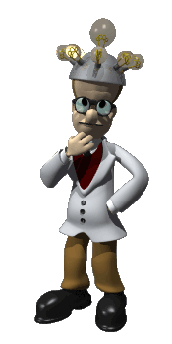
Schedule a Professional Development Workshop at Your Campus
Brian Jeffrey
Los Osos High School
6001 Milliken Ave
Rancho Cucamonga, CA 91737
Work Phone: 909-477-6900, extension 2337
Cell Phone: 909-553-9392
E-mail: mrj@mrjeffrey.com
Web Page: mrjeffrey.com

Slide 9
Targeting the Reading Zone
Presented by Brian Jeffrey, M. Ed.
Los Osos High School Rancho Cucamonga

